Slide 1

WELCOME

Slide 2
HIGH CLOUD AIRLINES
GROUP NO. 1

Slide 3
GROUP MEMBERS DETAILS
Mantha VijayKumar
Shaik Tanveer Ahamad
Ankitha
Chaitan Raju khairnar
Ratnadip Anil zagade
Punganuru Rajeshbabu Krishnavardhan Babu
Prajwal Mothilal Khandare

Slide 4
INTRODUCTION TO HIGH CLOUD AIRLINES
The High Cloud Airlines Project is a data analytics and visualization project designed to analyze and understand the operational performance of an airline using historical flight data. The main goal of this project is to transform large volumes of raw airline data into meaningful insights that help in better decision-making.
In this project, Excel, Tableau, Power BI is used as the primary tool to create an interactive and visually appealing dashboard. The dashboard focuses on key airline performance indicators such as Total Flights, Total Passengers, Load Factor Percentage, and Total Available Seats, analyzed across financial quarters.
Airline operations are highly influenced by seasonality, passenger demand, and capacity utilization. By analyzing data on a quarterly basis, this project helps identify travel trends, peak seasons, and operational efficiency.
This project also demonstrates the importance of data modeling, time intelligence, KPI calculation, and visualization techniques in real-world business scenarios.
The final dashboard is designed to be user-friendly, accurate, and decision-oriented, making it useful for airline management, analysts, and stakeholders.

Slide 5
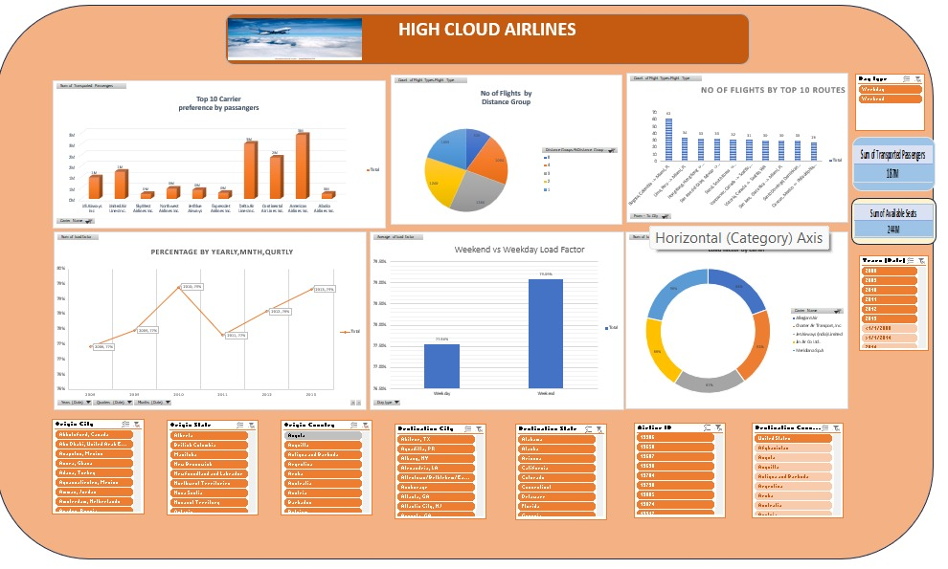
EXCEL DASHBOARD

Slide 6
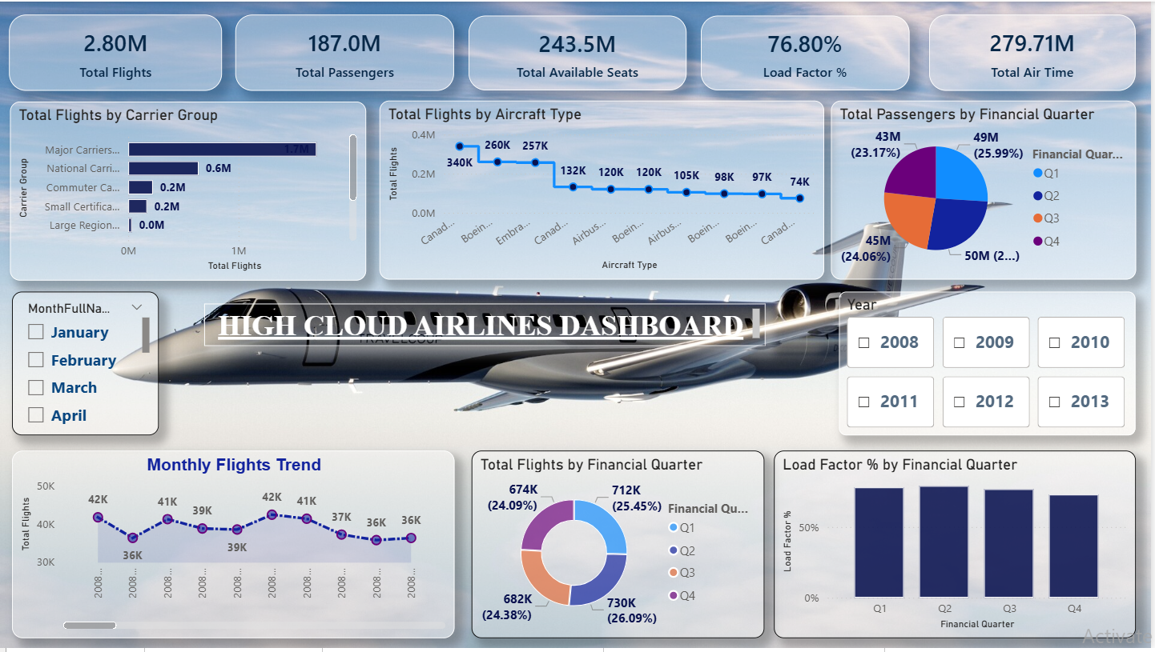
POWER_BI DASHBOARD

Slide 7
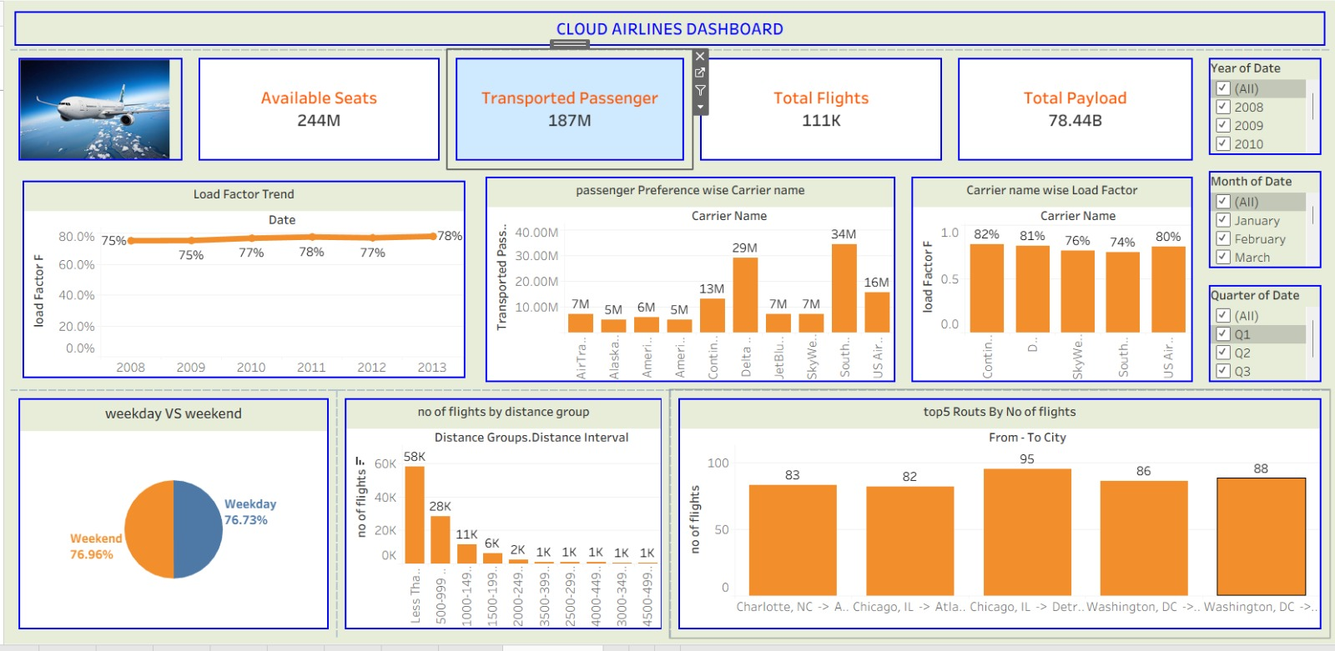
TABLEAU DASHBOARD

Slide 8
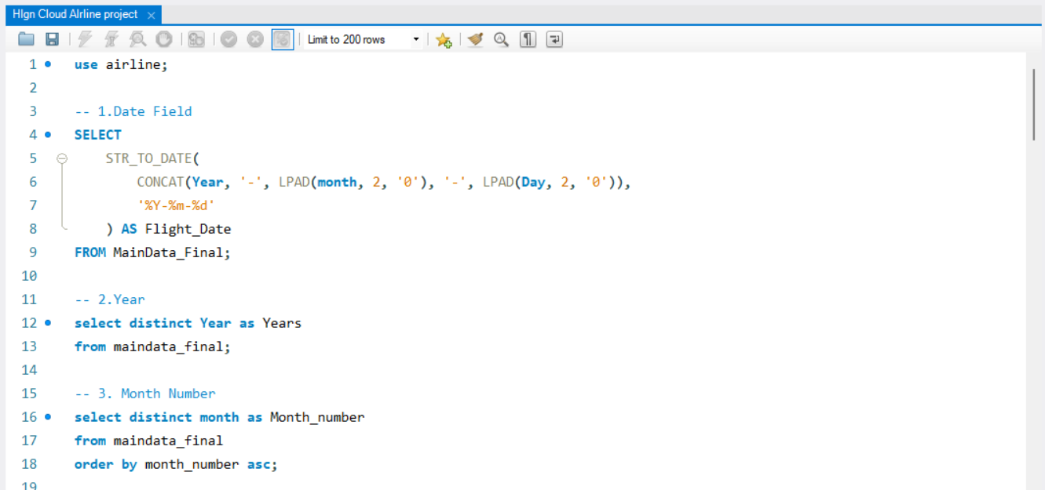
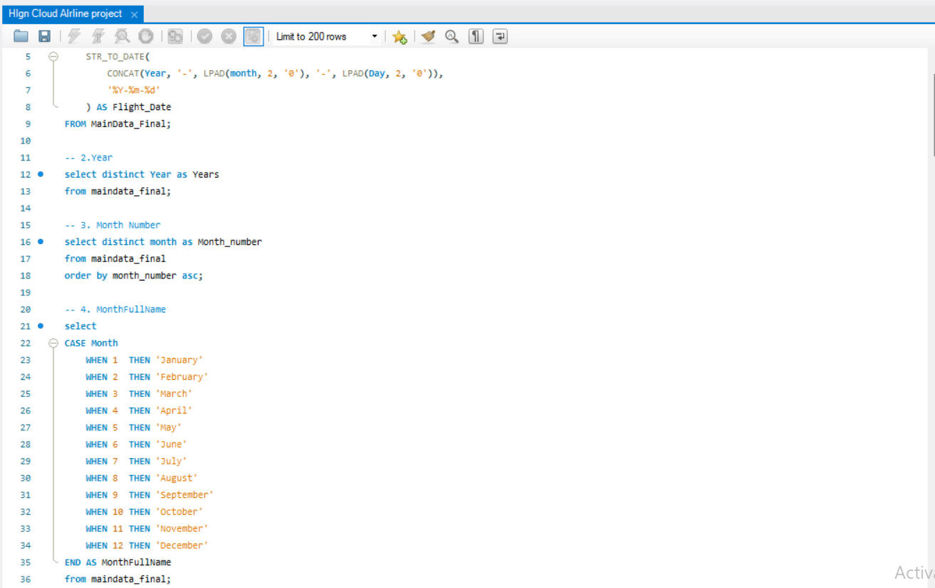
MY SQL QUERY

Slide 9
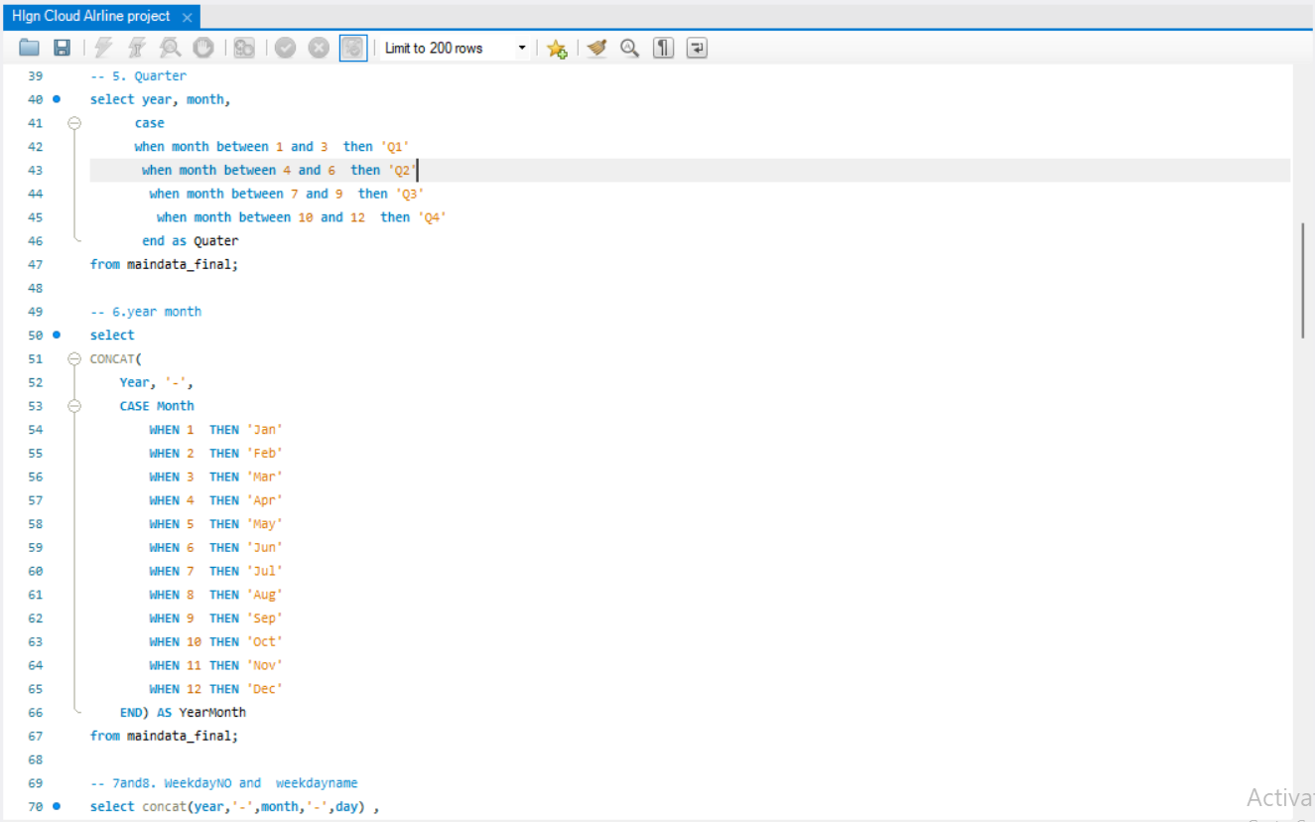
MY SQL QUERY

Slide 10
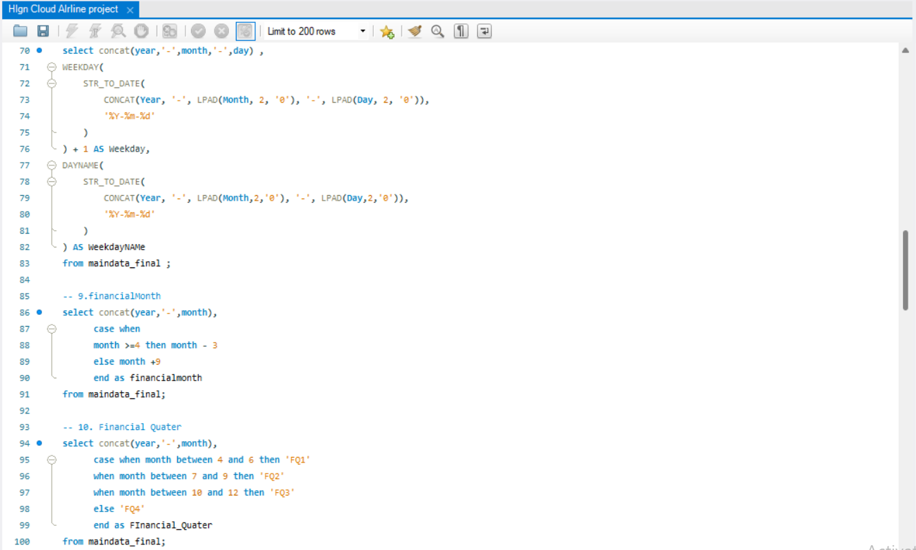
MY SQL QUERY

Slide 11
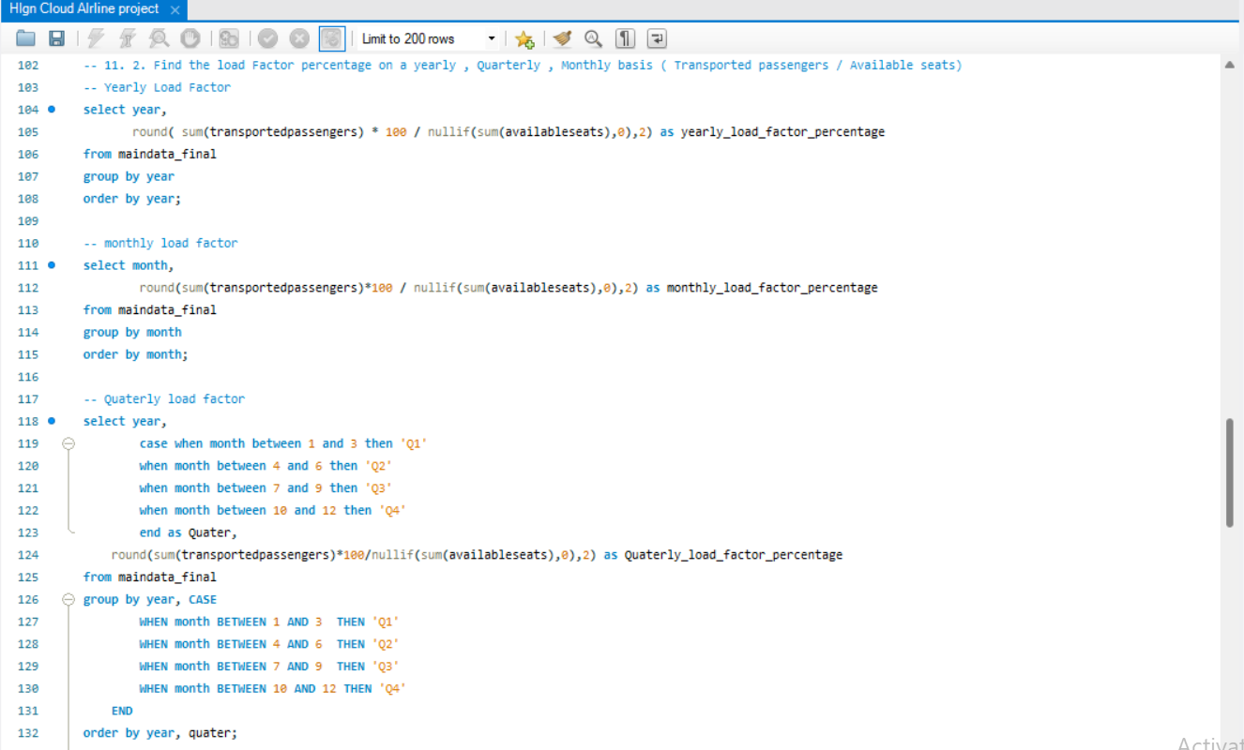
MY SQL QUERY

Slide 12
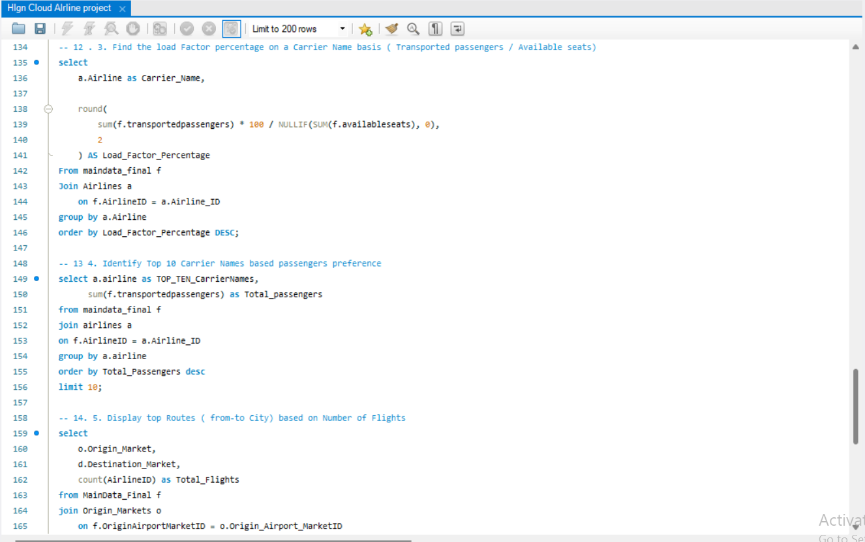
MY SQL QUERY

Slide 13
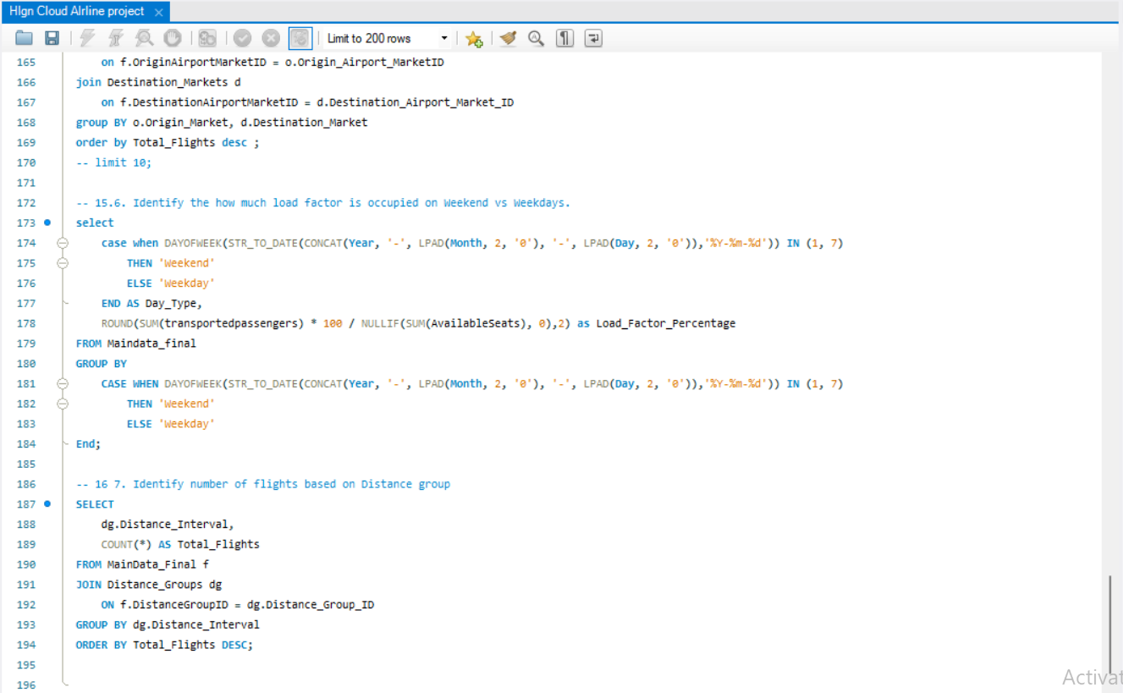
MY SQL QUERY

Slide 14
KPI
Find the load Factor percentage on a Carrier Name basis (Transported passengers / Available seats)
Find the load Factor percentage on a yearly , Quarterly , Monthly basis ( Transported passengers / Available seats)
calcuate the following fields from the YearMonth (#) Day fields ( First Create a Date Field from Year , Month , Day field
Display top Routes (from-to City) based on Number of Flights
Identify Top 10 Carrier Names based passengers preference
Identify the how much load factor is occupied on Weekend vs Weekdays.
Identify number of flights based on Distance group

Slide 15
KEY CHALLENGES
Managing and cleaning large airline datasets.
Creating accurate financial quarter and date-related columns.
Building correct relationships between fact and dimension tables.
Avoiding circular dependency and calculation errors in Power BI.
Calculating accurate Load Factor % without data inconsistency.
Ensuring proper sorting of months and quarters in visuals

Slide 16
PROBLEM STATEMENT
Airline organizations generate large volumes of operational data related to flights, passengers, and seat capacity. However, this data is often difficult to analyze due to its size and complexity. There is a need for an interactive and automated dashboard that can analyze airline performance across financial quarters and provide meaningful insights on passenger demand, flight operations, and load factor efficiency to support data-driven decision making.

Slide 17
Summary
The High Cloud Airlines Project is a comprehensive data analytics initiative developed using Power BI to analyze and visualize airline operational performance. The project focuses on transforming large and complex flight datasets into interactive dashboards that provide clear and actionable insights.
Key performance indicators such as Total Flights, Total Passengers, Load Factor Percentage, and Total Available Seats are calculated and analyzed across financial quarters. This helps in identifying seasonal trends, passenger demand patterns, and capacity utilization efficiency.
The project emphasizes data modeling, relationship management, KPI creation, and time-based analysis, ensuring accuracy and consistency in results.
By using effective visualizations and dashboard design principles, the project enables stakeholders to quickly understand airline performance and make data-driven business decisions.
Overall, this project demonstrates how business intelligence tools can be used to convert raw data into valuable insights, supporting strategic planning and operational improvement in the airline industry.

Slide 18
Conclusion
The High Cloud Airlines Project successfully demonstrates the use of Power BI to analyze and visualize complex airline operational data. By building an interactive dashboard with well-defined KPIs such as Total Flights, Total Passengers, Load Factor %, and Available Seats, the project provides a clear understanding of airline performance across financial quarters.
The analysis helps identify passenger demand trends, capacity utilization efficiency, and operational patterns that are difficult to observe from raw data. Through proper data modeling, calculated measures, and effective visualizations, the project supports data-driven decision making and improves business insight.
Overall, this project highlights the importance of business intelligence tools in the aviation industry and showcases how data analytics can enhance strategic planning and operational efficiency.

Slide 19
Thank you . . . . .

